Slide 1
5th Annual Civility in the Criminal Bar Event
“Do as adversaries do in law, strive mightily, and eat and drink as friends”
– Wm. Shakespeare
November 8, 2023
Notes:
2023
Del/Gerri-Lyn/Laura

Slide 2
Introduction
Welcome
Purpose
Notes:
2023 – Gerri-Lyn / Laura

Slide 3
Agenda
Introduction
- Gerri-Lyn Nelson, BCPS & Laura McPheeters, defence counsel
Part 1 : Benchers’ Thoughts on Civility
- Phil Riddell, KC (Life Bencher) & Lisa Dumbrell
Part 2: Civility Discussion Scenarios
- Honourable Justice Austin Cullen, BCSC, retired
Honourable Judge David St. Pierre, BCPC
Daniel Song, KC, defence counsel
Alix Rice, PPSC (Federal Crown)
Paul Pearson, BCPS (Provincial Crown)
Part 3: Q&A
Closing Remarks & Trivia
Notes:
2023 Gerri-Lyn/Laura
Ask people to use the Q&A button to put their questions in – not the chat. Laura will be the question master today.

Slide 4
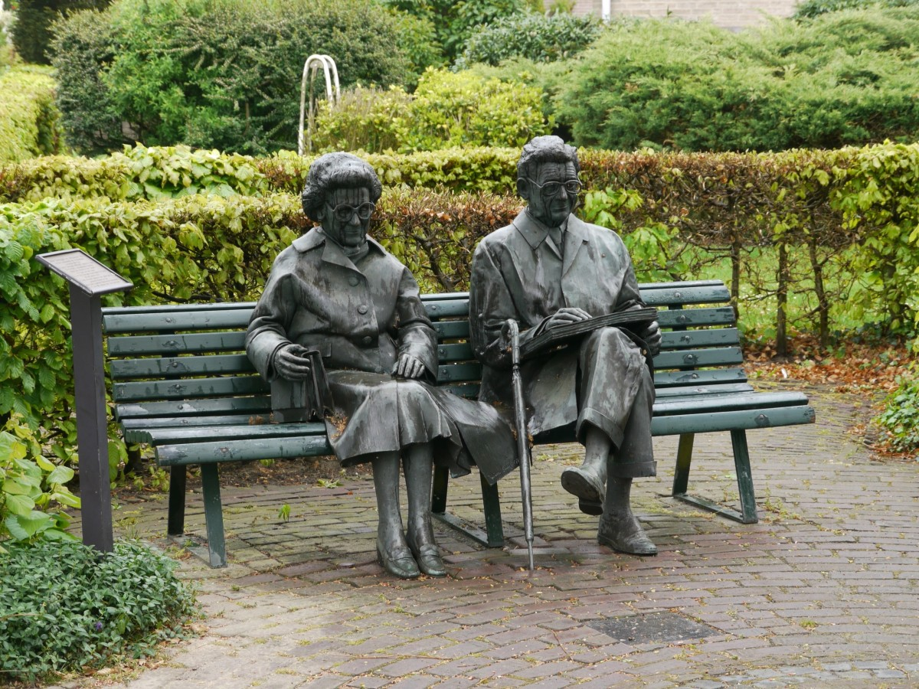
Benchers’ Thoughts on Civility
MS Teams: remember where you are
You are not your client… or your complainant
Sharp practice you know it when you see it
Know what you don’t know- juniors and senior counsel
Sexism and Civility
Notes:
2023 Phil/Lisa
Bencher #1

Slide 5
Code of Professional Conduct- highlights
Chapter 2: legal ethics, and obligations
Chapter 3- relationship to clients: competence, honesty & candor, prohibition against inducement for withdrawal of criminal or regulatory proceedings (consent of crown required), conflicts, withdrawal from representation for non-payment of fees, withdrawal generally and timing
Chapter 5: lawyer as advocate, Undertakings, duty of prosecutors, duty of courtesy
Chapter 6: harassment and discrimination
Chapter 7: relationship to the Society and other lawyers- Undertakings, courtesy and Good faith, communications, maintaining professional integrity and judgment
Notes:
2023
Bencher #2

Slide 6
Harassment 6.3-2 A lawyer must not harass a colleague, employee, client or any other person.
CODE OF PROFESSIONAL CONDUCT
Notes:
2023 Phil/Lisa
Bencher 3

Slide 7
[
[1] Harassment can be defined as an incident or a series of incidents involving physical, verbal or non-verbal conduct (including electronic communications) that might reasonably be expected to cause humiliation, offence or intimidation to the person who is subjected to the conduct. The intent of the lawyer engaging in the conduct is not determinative. Harassment may constitute or be linked to discrimination.
[2] Harassment can arise in many different circumstances. The following examples are intended to provide illustrations of circumstances that are likely to constitute harassment. The examples are not exhaustive.
(a) objectionable or offensive behaviour that is known or ought reasonably to be known to be unwelcome, including comments and displays that demean, belittle, intimidate or cause humiliation or embarrassment;
(b) behaviour that is degrading, threatening or abusive, whether physically, mentally or emotionally;
(c) bullying;
(d) verbal abuse;
(e) abuse of authority where a lawyer uses the power inherent in their position to endanger, undermine, intimidate, or threaten a person, or otherwise interfere with another person’s career;
(f) comments, jokes or innuendos that are known or ought reasonably to be known to cause humiliation, embarrassment or offence, or that by their nature, and in their context, are clearly embarrassing, humiliating or offensive; or
(g) assigning work inequitably.
COMMENTARY-CODE OF PROFESSIONAL CONDUCT 6.3-2
Notes:
2023 Phil/Lisa
Bencher #4

Slide 8
[3] Bullying, including cyberbullying, is a form of harassment. It may involve physical, verbal or non-verbal conduct. It is characterized by conduct that might reasonably be expected to harm or damage the physical or psychological integrity of another person, their reputation or their property. Bullying can arise in many different circumstances. The following examples are intended to provide illustrations of circumstances that are likely to constitute bullying. The examples are not exhaustive. (a) unfair or excessive criticism; (b) ridicule; (c) humiliation; (d) exclusion or isolation; (e) constantly changing or setting unrealistic work targets; or (f) threats or intimidation.
COMMENTARY-CODE OF PROFESSIONAL CONDUCT 6.3-2
Notes:
2023 Phil/Lisa
Bencher #5

Slide 9
Sexual harassment 6.3-3 A lawyer must not sexually harass a colleague, employee, client or any other person.
CODE OF PROFESSIONAL CONDUCT
Notes:
2023 Phil/Lisa
Bencher #6

Slide 10
CODE OF PROFESSIONAL CONDUCT COMMENTARY 6.3-3
[1] Sexual harassment can be defined as an incident or series of incidents involving unsolicited or unwelcome sexual advances or requests, or other unwelcome physical, verbal, or nonverbal conduct (including electronic communications) of a sexual nature. Sexual harassment can be directed at others based on their gender, gender identity, gender expression, or sexual orientation. The intent of the lawyer engaging in the conduct is not determinative. Sexual harassment may occur:
(a) when such conduct might reasonably be expected to cause insecurity, discomfort, offence, or humiliation to the person who is subjected to the conduct;
(b) when submission to such conduct is implicitly or explicitly made a condition for the provision of professional services;
(c) when submission to such conduct is implicitly or explicitly made a condition of employment;
(d) when submission to or rejection of such conduct is used as a basis for any employment decision, including;
(i) loss of opportunity;
(ii) the allocation of work;
(iii) promotion or demotion;
(iv) remuneration or loss of remuneration;
(v) job security; or
(vi) benefits affecting the employee;
(e) when such conduct has the purpose or the effect of interfering with a person's work performance or creating an intimidating, hostile, or offensive work environment;
(f) when a position of power is used to import sexual requirements into the workplace and negatively alter the working conditions of employees or colleagues; or
(g) when a sexual solicitation or advance is made by a lawyer who is in a position to confer any benefit on, or deny any benefit to, the recipient of the solicitation or advance, if the lawyer making the solicitation or advance knows or ought reasonably to know that it is unwelcome.
Notes:
2023 Phil/Lisa
Bencher #7

Slide 11
WITHOUT PREJUDICE OR ADMISSION Sir, I have just left the Court. Just a few minutes ago, as you hid behind your status like a coward, you made comments about me that were both unjust and unjustified, scattering them here and there in a decision the good faith of which will most likely be argued before our Court of Appeal. Because you ducked out quickly and refused to hear me, I have chosen to write a letter as an entirely personal response to the equally personal remarks you permitted yourself to make about me. This letter, therefore, is from man to man and is outside the ambit of my profession and your functions. If no one has ever told you the following, then it is high time someone did. Your chronic inability to master any social skills (to use an expression in English, that language you love so much), which has caused you to become pedantic, aggressive and petty in your daily life, makes no difference to me; after all, it seems to suit you well. Your deliberate expression of these character traits while exercising your judicial functions, however, and your having made them your trademark concern me a great deal, and I feel that it is appropriate to tell you.
You should wait and think about it before sending the letter
Notes:
2023 Phil/Lisa
Bencher #8 - continues on next slide

Slide 12
Your legal knowledge, which appears to have earned the approval of a certain number of your colleagues, is far from sufficient to make you the person you could or should be professionally. Your determination to obliterate any humanity from your judicial position, your essentially non-existent listening skills, and your propensity to use your court — where you lack the courage to hear opinions contrary to your own — to launch ugly, vulgar, and mean personal attacks not only confirms that you are as loathsome as suspected, but also casts shame on you as a judge, that most extraordinarily important function that was entrusted to you. I would have very much liked to say this to your face, but I highly doubt that, given your arrogance, you are able to face your detractors without hiding behind your judicial position. Worst of all, you possess the most appalling of all defects for a man in your position: You are fundamentally unjust. I doubt that that will ever change. Sincerely, Gilles Doré P.S. As this letter is purely personal, I see no need to distribute it.
Doré v. Barreau
du Québec, 2012 SCC 12
Notes:
2023 Phil/Lisa
Bencher #9 LAST BENCHER SLIDE. DISCUSSION GROUP UP NEXT

Slide 13
Part 2 - Discussion Scenarios
This Photo by Unknown Author is licensed under CC BY-SA-NC
This Photo by Unknown Author is licensed under CC BY-NC-ND
This Photo by Unknown Author is licensed under CC BY-NC-ND
This Photo by Unknown Author is licensed under CC BY-NC-ND
This Photo by Unknown Author is licensed under CC BY-NC-ND
Notes:
2023 Introduce the panel of 5
Straight into scenarios. Some same as previous years because the issues continue, also added some new ones to mix things up

Slide 14
Scenario #1 – Distraught Counsel
You attend at court for trial (or hearing or application) and it is clear that opposing counsel is distressed or otherwise unwell.
Notes:
Lead = Alix
Does it make a difference what your role is (Crown, defence, Judge?)

Slide 15
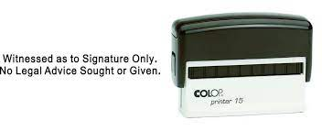
Scenario #2 – Advice or Bullying?
Lawyers were born to help.
Senior lawyers like to give advice, especially to junior lawyers, whether that advice is sought, welcome or warranted.
When well-meaning “help” turns patronizing.
See Singh et al v Braich 2023 ONSC 5053
para 24
Notes:
Lead = Paul
Expectations – keep ‘em real. You WILL be patronized. You can either embrace it or take umbrage, your choice
We’ve probably all done it. Even when advice is neither welcome nor warranted.
Years of experience does not equal the right to patronize others.
Call date / calling of files.
Lawyers like to help and give advice, especially to junior lawyers, whether that advice is sought or not.
2023 ONSC 5053 (CanLII) | Singh et. al. v Braich | CanLII

Slide 16
Obiter
Defining the Challenge.
Civility vs Collegiality
Notes:
Obiter 1 - Judge StP or Justice Cullen

Slide 17
Scenario #3 – “Sort it out”
You are in a trial that has become tense between counsel. You will only speak to your friend in Court and on the record. There is an issue that needs to be sorted out before the proceedings can continue. The Judge tells counsel to “sort it out and come back”.
What do you do?
How do you prevent it?
What if you are in a small community and have to work together every day – does this change things?
Notes:
Lead = Daniel (notes: you go and sort it out – and only this – in an unemotionally charged way and get back to it. And think about The Record when you come back to court. What can the Court do in this circumstance to help things along? - let Court adjudicate the legal issue, not the personality issues – Balls and strikes)
(notes; What can you do? Get help! Call a Bencher – get the Bencher to mediate. Focus on your role/job/file. What is the touchstone: doing your job. Deal with the issue at hand period. Try to set a new relationship without reacting. It requires one of the two to take a leadership role. (Smithers, fist fight, family file) So many examples of this both generally in a community and specific files.

Slide 18
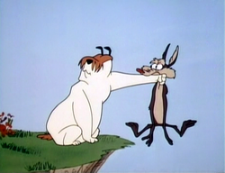
Scenario #4 –When “My Friend” is also my neighbour
There is an opposing lawyer in your local community with whom you do not get along. The relationship has descended to “in writing” or “on the record” communication.
Because it is a small community, not being
on the same file in the future is not an option.
Notes:
Lead = Alix
include Laura to weigh in
(Sam Sheep and Wile E Coyote)

Slide 19
Obiter
A Proposed Definition
Notes:
Obiter 2 - Judge StP or Justice Cullen

Slide 20
Scenario #5 – “Card laid is a card played”
Defence counsel inadvertently, due to momentary distraction, does not object to an exhibit being admitted at trial. The issue is raised with the Court immediately thereafter, but Crown Counsel insists that once the exhibit is admitted into evidence it is “in”.
Is this Civility? Professionalism? Both?
What if the roles were reversed (e.g. due to oversight, the Crown fails to prove jurisdiction before closing its case)?
Notes:
Lead = Paul
R. v. Desjardin, 2019 ABCA 215 Scare factor!

Slide 21
Scenario #6 – Uniquely Challenging
What are some unique characteristics of sexual assault trials that present particular challenges to maintaining civility in the Courtroom?
Are there different challenges for defence counsel, Crown Counsel and complainant’s counsel?
What about your own mental health on these files?
Notes:
Lead = Daniel
Add Laura in for complainant’s counsel perspective

Slide 22
Obiter
Elements of Civility
Notes:
Obiter 3 - Judge St P or Justice Cullen

Slide 23
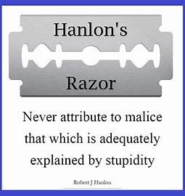
Scenario #7 – Persistent Late Notice
Defence counsel provides late notice shortly before a scheduled application. Again. And on the first day of trial, defence counsel raises an additional issue.
Is this uncivil, inconsiderate, strategic?
Is this a “Hanlon’s Razor” situation?
Notes:
Lead = Alix
Also refusing to make admissions
Hanlon’s razor = stupidity over malice

Slide 24
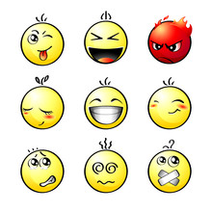
Scenario #8 – Misleading the Court
In the evening, following a long day in court, you receive an email from opposing counsel accusing you of misleading the court on a particular issue.
How do you respond?
Notes:
Lead = Paul
hot button trigger
24 hour rule. Don’t feel as though you have to respond to everything, right away, on a weekend. “If you are concerned about that I invite you to take it up with the trial judge”. Resist the urge to “merlot and email”. We need to step away from the 24 hour practice of law. All of us. Expectation ☹ [ Bigger discussion piece here] consider “please don’t feel the need to respond to this on the weekend”. OR, address it f2f with counsel after court rather than festering and sending an evening email.

Slide 25
Obiter
The Roots of Incivility
Notes:
Obiter 4 - Judge StP or Justice Cullen

Slide 26
Scenario #9 – Civility to Others
Do lawyers owe a duty of civility to
Witnesses (civilian, police, experts)
The public in the gallery (including family members)
Balancing the zealous xxam with a bigger picture view:
Does the conduct bring the administration of justice into disrepute?
Notes:
Lead = Daniel
A bigger picture (administrative of justice) not the bigger picture (appreciating that a wrongful conviction too is a vital issue

Slide 27
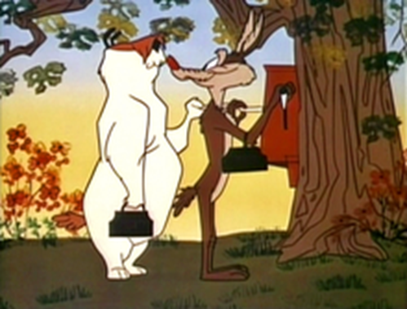
Scenario #10 – Civility & Diversity
Are some groups subjected to incivility more frequently than others?
Be nice to each other!!
Notes:
Lead = Paul
Sam Sheep and Wile E Coyote

Slide 28
Scenario #11 – Mental Health
Have we stopped caring for each other?
Have we strayed from our Shakespearean mantra?
To what extent can incivility undermine counsel’s mental health?
Notes:
Lead = Alix (closing out the scenarios)
The Shakespearean mantra being “Do as advocates do in law: Strive mightily and eat and drink as friends”

Slide 29
Obiter
Ways to Maintain Civility & Get it Back
Notes:
Obiter 5 (last one) – both Judges to address this

Slide 30
Q & A
Notes:
Q & A position – nice dark criminal justice graphic
Laura to read them out

Slide 31
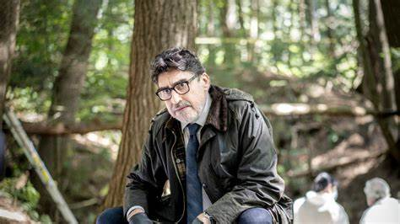
In Closing
“Is it true?
Is it kind
Does it need to be said?”
-Louise Penney’s character
Chief Inspector Armand Gamache
defining Civility for his team in
“A Better Man”
Notes:
2023
Some inspirational quotes on civility.
And now on to the trivia question.

Slide 32
Trivia Question
First two correct answers will receive an
autographed hard copy delivered to your office.
Notes:
With thanks to Dan and his publisher for the copies. Last year gave away his first book, this is the follow up
Trivia question

Slide 33
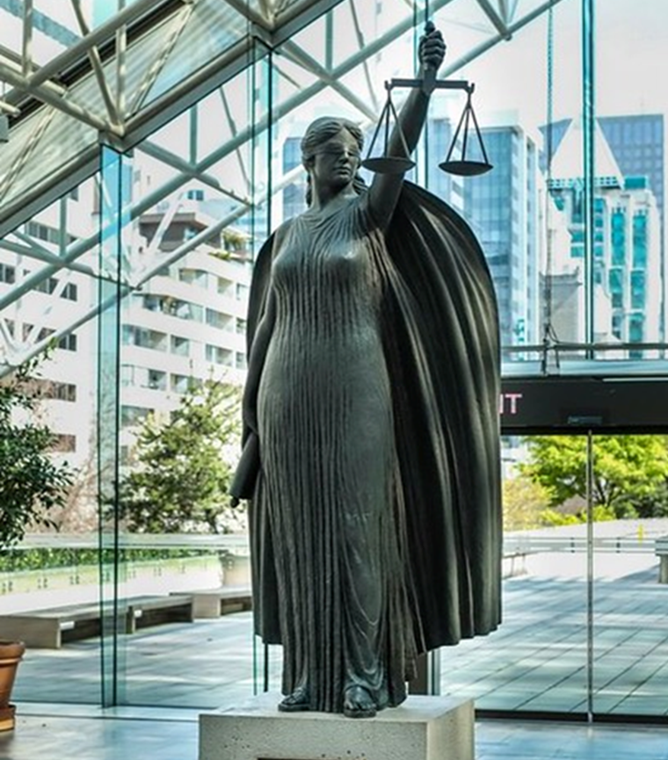
CPD Credit 2 hours ethics/PM credit
“Courthouse Libraries BC: Civility in the Criminal Bar: 5th Annual Lunch & Learn“
Notes:
Gerri-Lyn or Laura to close out with thanks to Courthouse Libraries, Del Friday and team
(And as always, quickest to search “exactly on” and grab it from the list)

