Slide 1
Reliability, Believability, and Vulnerability of Alibi Evidence
Stephanie Marion, PhD
York University
September 18th, 2023

Slide 2
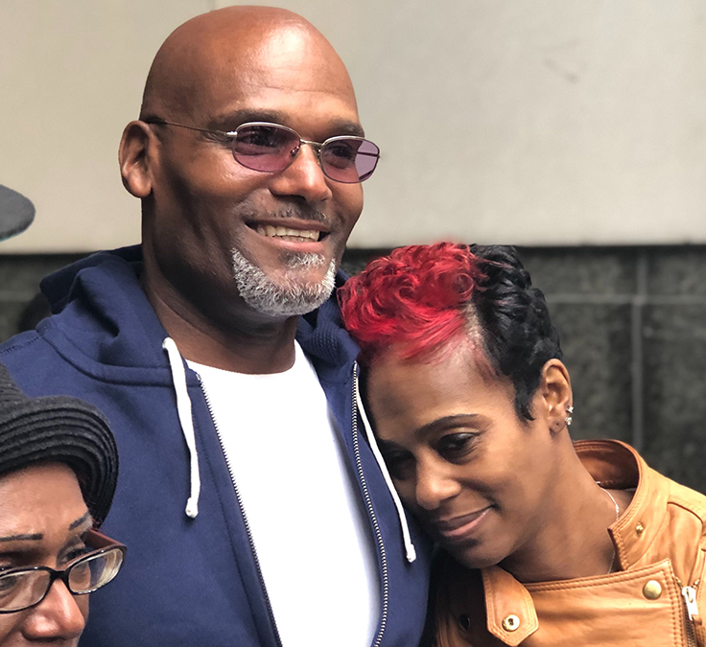
Willie Veasy
Drive-by shooting on January 24, 1992
Eyewitness IDs Veasy from a photo lineup after multiple attempts
Veasy was interrogated on June 9th
His alibi: playing basketball with friends
False confession: friend wanted revenge
A few days later, evidence was found that he was at work, washing dishes at a busy restaurant
Alibi discounted by investigators
Veasy convicted of second-degree murder

Slide 3
Alibi Evidence
What makes a “strong” alibi?
Why characteristics of a “weak” alibi are not diagnostic of deceitful alibis
What can be done to strengthen alibi evidence
Systemic and psychological barriers to generating and using alibi evidence

Slide 4
We know alibi evidence often fails
20 – 68% of wrongfully convicted individuals had alibis (Burke et al., 2007; Garrett, 2011; Heath et al., 2021; Wells et al., 1998)
Not 100%?
Sometimes determined to be contributing to the wrongful conviction – “weak alibi”
What is a “weak” alibi?
Not corroborated by any physical evidence
Corroborated by only “motivated” witness evidence (Olson & Wells, 2004)
Motivated to lie (e.g., to protect the suspect, out of fear of suspect retaliation, financial gain)
Close social and familial relationships
Contains inconsistencies

Slide 5
What kind of alibi is most believable?
The most persuasive alibis are those that are:
Corroborated by physical evidence (e.g., Dysart & Strange, 2012; Olson & Wells, 2004; Nieuwkamp et al., 2022)
Corroborated by “non-motivated” others (e.g., Olson & Wells, 2004)
Consistent alibis (e.g., Culhane & Hosch, 2012; Dysart & Strange, 2012)
Corroborated by multiple witnesses (e.g., Eastwood et al., 2013; 2016)
Corroborated by “knowledge” evidence (e.g., Nieuwkamp et al., 2022)

Slide 6
Physical evidence supporting alibis
Police estimates: Only present in 14-25% of investigations (Dysart & Strange, 2012; Turtle & Burke, 2003)
Even when it exists, physical evidence is not always easy to obtain
Only as good as a suspect’s memory
Advantages the privileged / disadvantages the vulnerable (Levine & Miller, 2021)

Slide 7
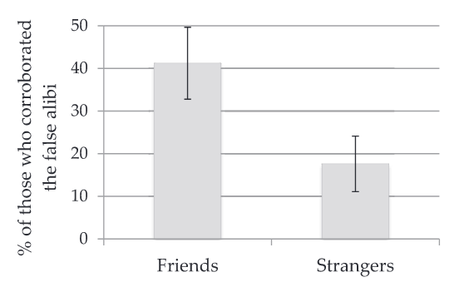
“Motivated” alibi corroborators
Experimental behavioural data supports the general belief: Marion & Burke (2013; 2017)
Alibis corroborated only by motivated witnesses are sometimes not rated as more believable than non-corroborated alibis (e.g., Dahl et al., 2009; Strange et al., 2014)

Slide 8
Your average alibi
Survey of US police officers (N = 68); varying ranks
Belief that suspects lie 78% of the time
Thus; may reflect sample of ”mostly” false alibis

Slide 9
Your average alibi
“Weakly” corroborated alibis are the most common form of alibi evidence among innocent “suspects”, based on self-report experiments

Slide 10
Your average alibi
“Weakly” corroborated alibis are the most common form of alibi evidence among innocent “suspects”, based on self-report experiments
Multiple witnesses: 28% - 64% (e.g., Culhane et al., 2008; Nieuwkamp et al., 2017)

Slide 11
Your average alibi
Culhane et al., 2008 (self-reported); Culhane et al., 2013 (validated)

Slide 12
Alibi consistency: Base rate of mistaken alibis
Police may underestimate the likelihood of honestly mistaken alibis (1 in 5) (Dysart & Strange, 2012)
Leins & Charman (2016) experiment: only 11% accurate when “suspect” engaged in non-schema-consistent behaviour; 83% accurate when schema-consistent
Olson & Charman (2012): 12% of innocent individuals initially reported completely inaccurate alibis
Cardenas et al., 2020:
Errors about who, where, AND what: 22%
Errors about who, where, OR what: 50%
=> Only 10% of potential corroborating pieces of evidence could be obtained

Slide 13
Your average alibi
Strange et al., 2014
Inconsistent alibis of innocent individuals appear to be the norm, not the exception
11.5% needed a whole narrative change
24.9% needed evidence change

Slide 14
Inconsistent alibis
Consistency is a key ingredient to believability
Any kind of change is met with skepticism
Police estimate that 4 in 5 changed alibis is indicative of a suspect lying
Yet consistency is NOT diagnostic of true alibis
False and rehearsed alibis have the potential to be more consistent than true alibis (Sakrisvold et al., 2017)
Alibi changes due to an attempt to cover up illegal or immoral behaviour may be better tolerated than changes due to memory errors! (Nieuwkamp et al., 2016)
Offering a mistaken alibi early in an investigation can set forensic confirmation bias into motion

Slide 15
Believability criteria are not diagnostic of truthfulness

Slide 16
Types of Alibis
True
Mistaken
False
Based on accurate memories
Memory failures
Likely based on part on memories

Slide 17
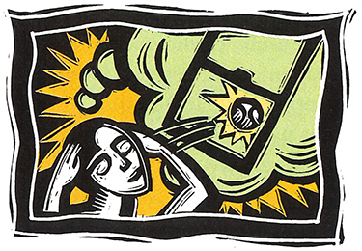
An alibi is a memory
Autobiographical memory => Mental time travel
Cognitive and social factors that influence the availability and reliability of memories
Encoding → Storage → Retrieval
Imagination inflation of a false alibi makes the “memory” of a false alibi just as vivid and convincing as a true alibi (Dhammaperra et al., 2020)
The validation of an alibi is also largely dependent on memory
Person evidence
Recollection of potential physical evidence
Credit: University of Washington Magazine

Slide 18
Why are good alibis so hard to generate?
Time
Reliance on schemas (in whole or in part) may lead to errors
Reliance on schemas increases confidence (e.g. Leins & Charman, 2016)
Mundane or repeat experiences are not well encoded
=> Source monitoring errors
Motivation CANNOT improve memory
Innocence itself may lower the threshold for reporting a memory
Retention
Time

Slide 19
Difficulty of validating an alibi
The burden of validation of an alibi is sometimes on the defendant
Dysart & Strange (2012): police investigate alibis 76% of the time; only 49% of officer believed a thorough investigation of a suspect’s alibi is always done before an arrest is made
Existing alibi evidence is not accessible to everyone / needs law enforcement or private defense to intervene
Only 1/3 of state and federal judges believe that ”failing to investigate or disclose a defendant’s alibi” should be investigates as possible prosecutorial misconduct (Cardenas et al., 2022)
Some good news: When alibi evidence IS strong, it has the potential to counteract persuasive evidence (e.g., DNA match probability evidence, Ribeiro et al., 2020)

Slide 20
How alibi evidence can be strengthened
Reduce reliance on schemas; allow memory aids
Matuku & Charman (2021)
3 minutes of memory aids
↑ in true alibis (16% → 51%)
↓ in mistaken alibis
Potentially warning suspects about the detrimental effect of mistaken alibis

Slide 21
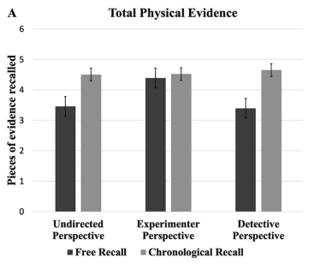
How alibi evidence can be strengthened
Increase potential for corroborating evidence by drawing on principles of human memory (e.g., Mosser & Evans, 2019)
E.g., Cognitive Interview strategies:
Context reinstatement
Forward vs Backward recounting
Multiples perspective
Potentially beneficial for alibi generation AND validation
Matuku & Charman (2020)

Slide 22
How alibi evidence can be strengthened
Alibi Generation Effect (Olson & Wells, 2012)
Research participants rate a suspect’s alibi as more believable when they have the opportunity to generate their own first

Slide 23
How alibi evidence can be strengthened
Increase detection of true vs false alibis
Like any other type of lie detection, detection of false alibis is low (43 – 60%, Culhane et al., 2013; )
Verifiability Approach:
Truth-telling pairs offer proportionately more verifiable information than lying pairs (Nahari & Vrij, 2014; Vernham et al., 2020)
Training on the verifiability approach for judging collective statements appears promising
Anecdotally, a thorough interview by the defense attorney can often spot lying alibi corroborators (Levine & Miller, 2021)

Slide 24
How alibi evidence can be strengthened
Investigative training and resources
Only 23% of U.S. police respondents in Dysart & Strange (2012) reported receiving training on how to interview alibi witnesses:
Police investigate alibis 76% of the time and 14% reported that alibis are rarely or only sometimes investigated before an arrest or warrant
Inquiry Regarding Thomas Sophonow:
Police should investigate alibi evidence, and take the same care as to not contaminate witness evidence as with suspect and eyewitness interviews
Alibi witnesses should not be suggested that they are mistaken; they should not be threatened or intimidated

Slide 25
Systemic corruption of alibi evidence
Levine & Miller (2021): Survey of U.S. Defense attorneys
“Strong” alibis are likely to be presented to the DA before trial, but
“if the alibi depends on testimony from a witness that the DA’s office can find and lean on with threats of VOPs or calling DFACS to their children, then I tend to play those cards a little closer to the vest.”
75% of defense attorneys surveys believed that the police and/or prosecutors regularly blur the timeline of the crime with the specific goal of hindering the establishment of an alibi.
Flipped burden of proof? (See also Burchill, 2018)

Slide 26
Systemic corruption of alibi evidence
Moore et al. (2014): coercive interrogations of eyewitnesses and alibi witnesses
Eric Morgan (aka “Action”); Brampton, ON, 2006
Reid technique used:
Eyewitness non-ID became an ID
Alibi witness recanted corroboration

Slide 27
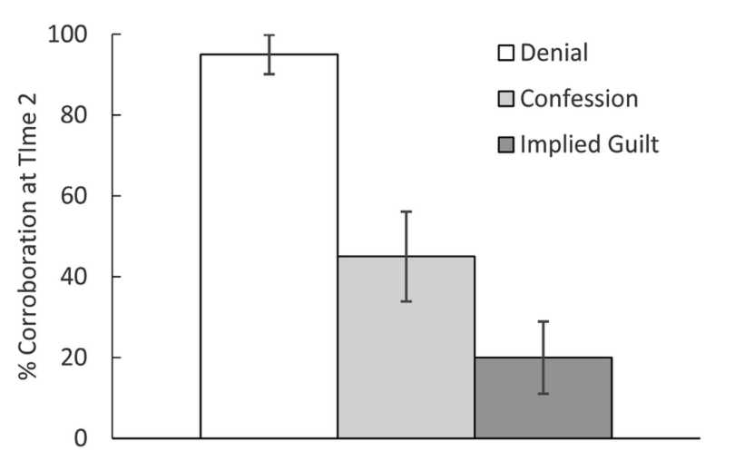
Systemic corruption of alibi evidence
Marion et al. (2016) experimental data:
Alibi witnesses recant their corroboration of a true alibi when:
informed of a confession (53% ↓)
collusion is implied (79% ↓)

Slide 28
Systemic corruption of alibi evidence
Marion et al. (2016) experimental data
David Milgaard
With friends on the morning of the murder of Gail Miller
Friends Ron Wilson and Nichol John initially corroborated the alibi
After several police interviews (interrogations?), both recanted the alibi and incriminated David

Slide 29
Systemic corruption of alibi evidence
Marion et al. (2016) experimental data
David Milgaard
John Kogut
Friends initially corroborated his alibi that he was at his girlfriend’s birthday party
When informed of Kogut’s confession, they no longer corroborated his alibi, apparently doubting their memory

Slide 30
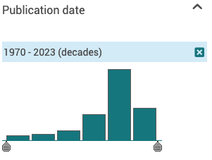
The good news: research on alibi evidence steadily increasing
2020 – 2029
Thank you!
Stephanie Marion
marionst@glendon.yorku.ca

Slide 31
References
Burke, T. M., Turtle, J.W., & Olson, E. A. (2007). Alibis in criminal investigations and trials. In M. P. Toglia, J. D. Read, D. F. Ross, & R. C. L. Lindsay (Eds.), The handbook of eyewitness psychology ( Memory for events ) (Vol. 1, pp. 157– 174). Lawrence Earlbaum Associates.
Culhane, S. E., & Hosch, H. M. (2012). Changed alibis: Current law enforcement, future law enforcement, and layperson reactions. Criminal Justice and Behavior, 39, 958– 977. https://doi. org/10.1177/0093854812438185
Dysart, J. E., & Strange, D. (2012). Beliefs about alibis and alibi investigations: A survey of law enforcement. Psychology, Crime and Law, 18(1), 11– 25. https://doi.org/10.108 0/1068316X.2011.562867
Eastwood, J., Snook, B., & Au, D. (2016). Safety in numbers: A policy-capturing study of the alibi assessment process. Applied Cognitive Psychology, 30(2), 260– 269. https://doi.org/10.1002/ acp.3200
Garrett, B. L. (2011). Convicting the innocent: Where criminal prosecutions go wrong. Harvard Univ. Press. Heath et al., 2021;
Levine, K. L. & Miller, C. (2012). The strategic use of alibi defenses. Emory Legal Studies Research Paper, 21(1), http://dx.doi.org/10.2139/ssrn.3798769
Marion, S. B., Kukucka, J., Collins, C., Kassin, S., & Burke, T. M. (2016). Lost proof of innocence: The impact of confessions on alibi evidence. Law and Human Behavior, 40, 65-71. doi: 10.1037/lhb0000156
Matuku, K., & Charman, S. D. (2020). Enhancing innocent suspects’ memories for corroborating alibi evidence. Psychology, Public Policy, and Law, 26(4), 442. https://doi.org/10.1037/ law0000264
Moore, T.E., Cutler, B.L., & Shulman, D. (2014). Shaping eyewitness and alibi testimony with coercive interview practices. The Champion, Oct. 34-42.
Nieuwkamp, R., Horselenberg, R., & van Koppen, P. (2022). You don't know: knowledge as supportive alibi evidence. Psychiatry Psychology and Law. Advance online publication. https://doi.org/10.1080/13218719.2022.2116608
Olson, E. A., & Wells, G. L. (2004). What makes a good alibi? A proposed taxonomy. Law and Human Behavior, 28(2), 157– 176. https://doi.org/10.1023/B:LAHU.0000022320.47112.d3
Ribeiro, G., Tangen, J., & McKimmie, B. (2020). Does DNA evidence in the form of a likelihood ratio affect perceivers’ sensitivity to the strength of a suspect’s alibi? Psychonomic Bulletin & Review, 27, 1325– 1332. https://doi.org/10.3758/s13423-­020-­01784-­x
Wells, G. L., Small, M., Penrod, S., Malpass, R. S., Fulero, S. M., & Brimacombe, C. E. (1998). Eyewitness identification procedures: Recommendations for lineups and photospreads. Law and Human Behavior, 22(6), 603– 647.

