Slide 1
Ubi jus, ibi remedium: Section 24(2) of The Constitution Act, 1982 Nicole O’Byrne, Ph.D. UNB Faculty of Law
Criminal Defence Advocacy Society & the BC Court House Library Society Scholars’ Series
March 12th, 2024
via zoom

Slide 2
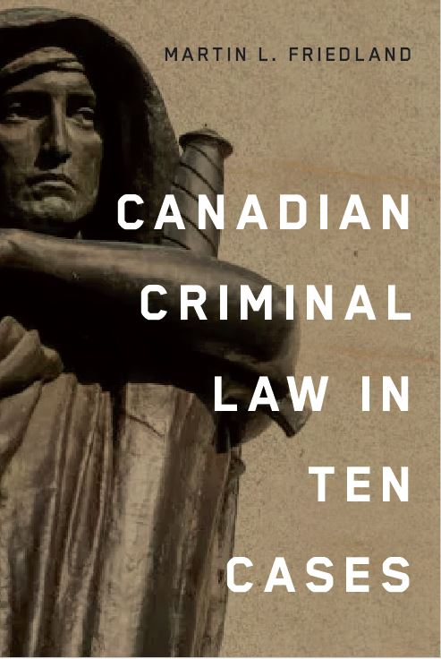
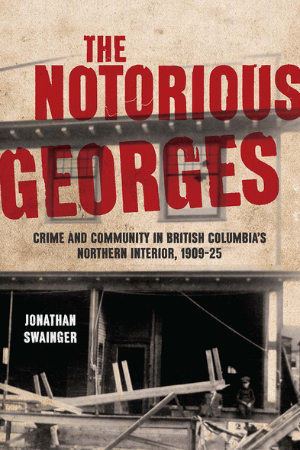

Slide 3
Overview
The Purpose of the Rules of Evidence
The Rights Spectrum
The Inclusionary/Exclusionary Rule
A Canadian Compromise?
The Purposes of Section 24(2)
The Two-Box Model
Police Misconduct
Involuntary Confessions
Electronic Evidence

Slide 4
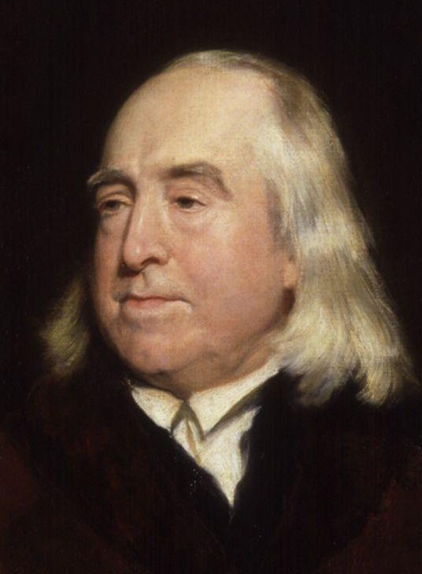
ALL RELEVANT EVIDENCE IS ADMISSIBLE
Jeremy Bentham
(1748-1832)

Slide 5
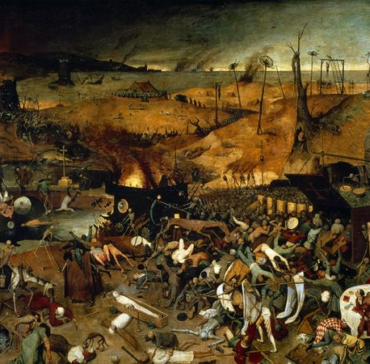
The dark ages….
What is the common law re the admissibility of illegally obtained evidence?
The Inclusionary Rule
“It matters not how you get it; if you steal it even it would be admissible in evidence.”
Crompton J. (1861)

Slide 6
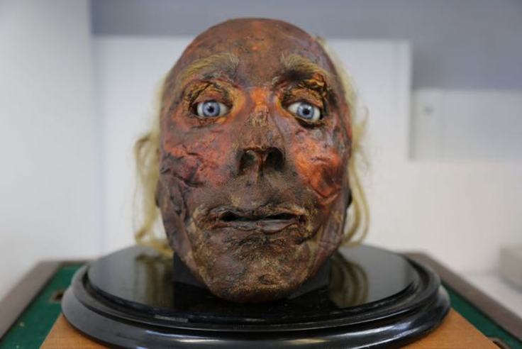
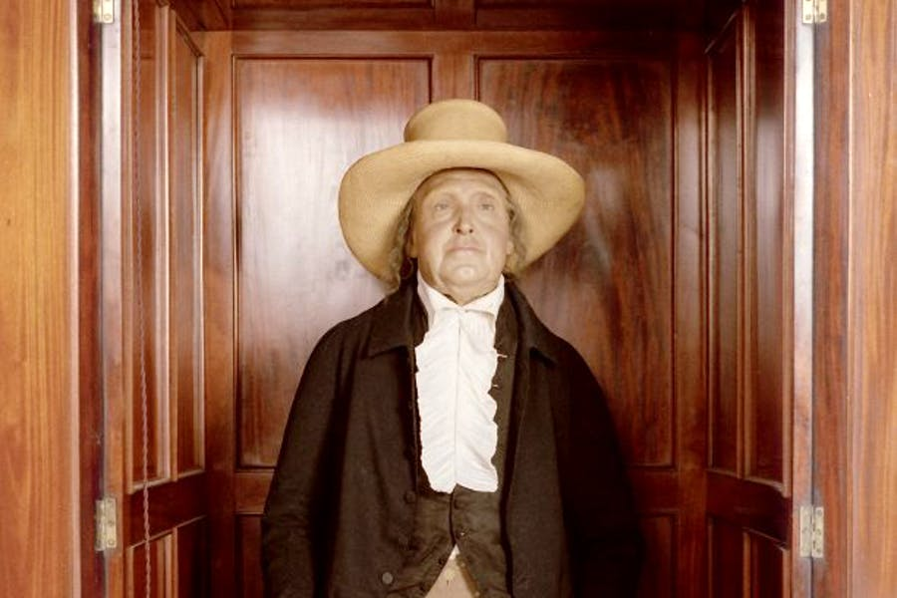
R. v. Wray [1971]
The court follows the common law rule in Kuruma, Son of Kaniu v R:
“…the test to be applied in considering whether evidence is admissible is whether it is relevant to the matter in issue. If it is, it is admissible and the court is not concerned with how the evidence was obtained.”
The dark side of Bentham…

Slide 7
R. v. Wray [1971]
No judicial discretion at common law to exclude evidence on the ground that its admission would bring the administration of justice into disrepute.
Justice Martland

Slide 8
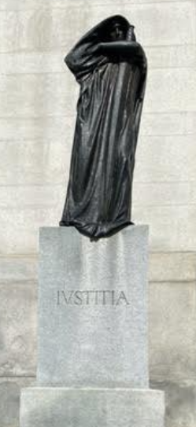
Ubi jus ibi remedium
Where there is a right, there is a remedy.

Slide 9
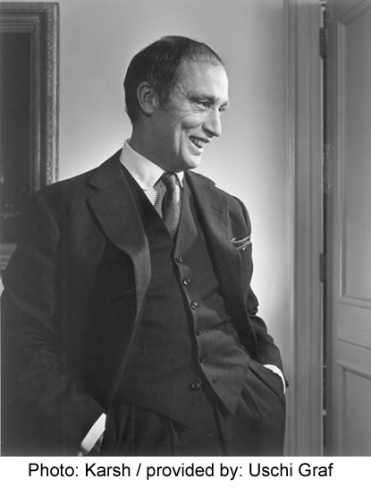
1982: A rights revolution?
What limits and boundaries frame our constitutional rights?
Section 1: The Canadian Charter of Rights and Freedoms guarantees the rights and freedoms set out in it subject only to such reasonable limits prescribed by law as can be demonstrably justified in a free and democratic society and….

Slide 10
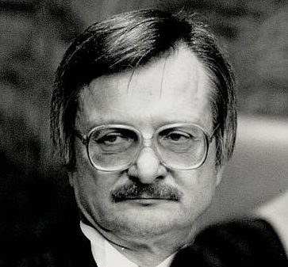
The Purpose of the Rules of Evidence
“…to facilitate the introduction of all logically relevant facts without sacrificing any fundamental policy of the law which may be of more importance than the ascertainment of the truth.”
Justice Sopinka

Slide 11
Where do you sit on the rights spectrum?
TRUTH
FAIRNESS
SOCIETY
INDIVIDUAL
UTILITY
RIGHTS

Slide 13
Inclusionary rule
Exclusionary Rule

Slide 14
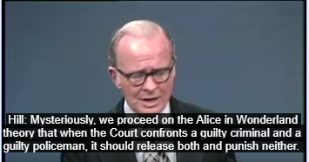
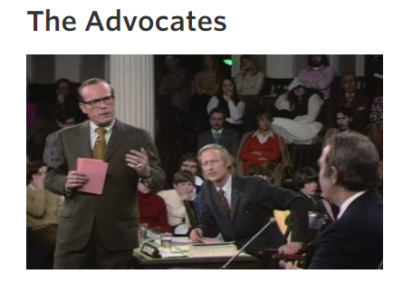
Debating the Exclusionary Rule…
http://openvault.wgbh.org/catalog/V_A0C303BBB46944AEBC1385E652717CE0

Slide 15
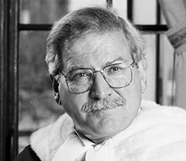

Slide 16
A Canadian-style Compromise?
24. (2) Where, in proceedings under section (1), a court concludes that evidence was obtained in a manner that infringed or denied any rights or freedoms guaranteed by this Charter, the evidence shall be excluded if it is established that, having regard to all circumstances, the admission of it in the proceedings would bring the administration of justice into disrepute.

Slide 17
The Four Purposes of Section 24(2)
Remedial: to put the accused back into the situation prior to the breach.
Enforcement: to deter bad policing.
Reputational: to distance courts from the consequences of bad police conduct.
Trial Fairness: to focus on the administration of justice.

Slide 18
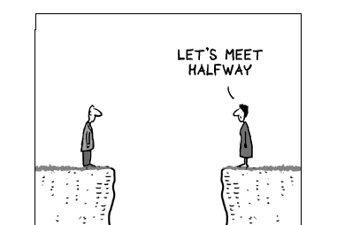

Slide 19
24(2) and the Two-box Model
In R. v. Collins, the SCC categorized several factors important to the interpretation of section 24(2):
1) The effect of the admission of the evidence on the fairness of the trial.
2) The seriousness of the breach.
3) The effect of excluding the evidence on the repute of the administration of justice.
Purpose: To give trial judges guidance when applying a discretionary remedy.

Slide 20
R. v. Stillman [1997]
On the evening of April 12, 1991, a group of seven teenagers gathered in the Oromocto area, in New Brunswick. They walked to a camp in the woods where they drank beer and wine and shared some LSD. Between 8:00 p.m. and 8:30 p.m. the 17‑year‑old appellant, William Stillman, and the 14‑year‑old victim, Pamela Bischoff, left the group. When he arrived at his home between 11:45 p.m. and midnight, the appellant was obviously cold, shaken and wet from the upper thighs down. He was cut above one eye, and had mud and grass on his pants. The explanation he gave for his condition was that he had been in a fight with five Indians. This explanation, as well as his account of where he had last seen the victim, varied over time.

Slide 21
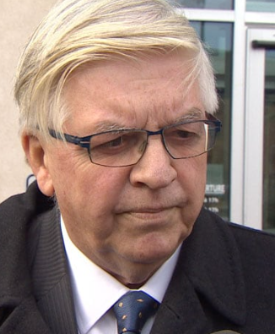
R. v. Stillman [1997]
“This is to confirm that we have advised this young person that he is not to consent to provide any bodily samples whatsoever including hair and or teeth imprints to you or anybody else.”
Gary Miller K.C.

Slide 22
The Collins/Stillman Framework
Trial Fairness becomes key consideration
If evidence deemed conscriptive then it would likely be excluded.

Slide 23
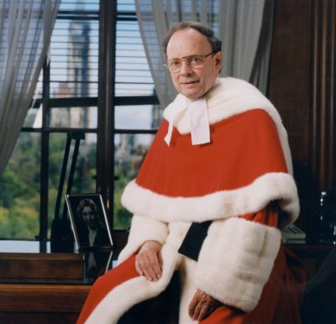
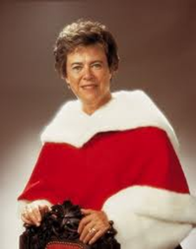
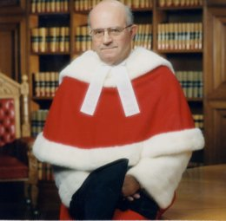
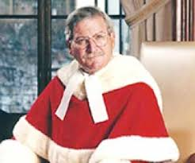
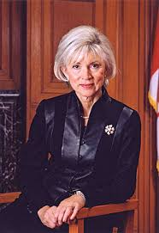
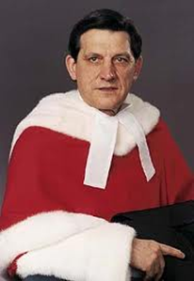
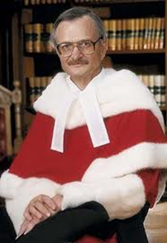
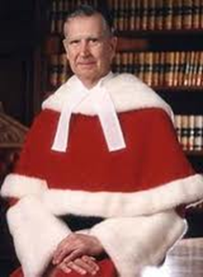
R. v. Stillman
The Minority

Slide 24
“Section 24(2) introduces a balancing process.”

Slide 26
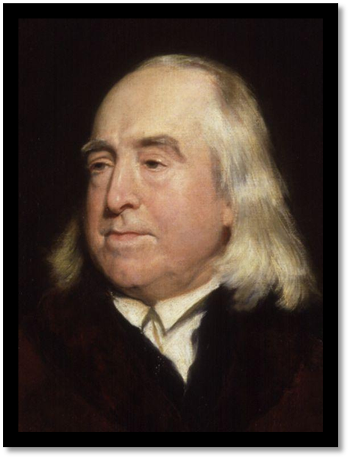
ALL RELEVANT EVIDENCE IS ADMISSIBLE
Jeremy Bentham (1748-1832)

Slide 27
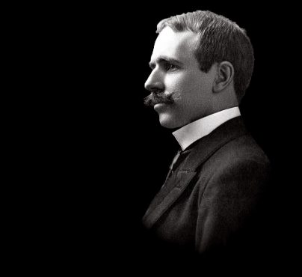
The Supreme Commander of the Law of Evidence
Wigmore on Evidence (1904)
Book dedicated to Bentham
The Principled Approach
Trustworthiness - Reliability
John Henry Wigmore
(1863-1943)

Slide 28
Police Misconduct
In Grant, McLachlin CJC stated that good faith breaches by police diminish the need for the courts to disassociate themselves from the conduct.
However, concepts such as police (mis) conduct and good faith policing not clearly defined.
Are we back to R. v. Wray?
See: Patrick McGuinty, “Section 24 (2) of the Charter: Exploring the Role of Police Conduct in the Grant Analysis,” (2018) 41 Manitoba LJ 273.

Slide 29
Police Misconduct
“If what the cops did pisses me off then I exclude it.”
– an anonymous Provincial Court Judge

Slide 30
Involuntary Confessions
Involuntary confessions are inadmissible Ibrahim v. The King [1914]
However, involuntary statements can be used to get search warrants and the evidence obtained may be admissible (‘fresh start’)
In Grant, McLachlin cautioned that a more flexible approach may encourage police to improperly obtain evidence in order to find derivative evidence that may be deemed admissible.
See R. v. Côté [2011] 3 S.C.R. 215

Slide 31
Electronic Evidence
Presumption of Reliability
Personal Device Searches
Low Bar for Relevance
See: Lauren-Jean Ogden, “Taken for Grant-ed: Assessing the Short-Comings of the Grant Test’s Application to the Evidence Obtained from Personal Devices,” Man LJ 45(2022): 26-47.

Slide 32
R. v. Vu [2013]
"It is difficult to imagine a more intrusive invasion of privacy than the search of a personal or home computer."
- Justice Cromwell
The violation is not serious as the law was unclear at the time.

Slide 33
R. v. Fearon [2014]
Is there a common law power incident to arrest to search a cell phone?
The law is UNCLEAR.
Skewed towards admissibility of personal device evidence.

Slide 34
R. v. Sabiston 2023 SKCA 105
On July 23, 2019, in a neighbourhood in south-central Regina described by the officers in this case as frequented by gang associates and gang violence, two members of the Regina Police Service’s [RPS] gang unit arrested Stuart Sabiston for possession of stolen property, namely the bullet-proof vest he wore that day. In the course of being searched incident to that arrest, police located a folding knife in Mr. Sabiston’s pocket. Mr. Sabiston then told police that he had a firearm in his backpack. A loaded prohibited firearm was subsequently seized by the officers.

Slide 35
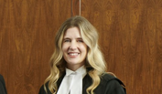
Justice Drennan
In concluding this, I note that “[w]hile police are not expected to engage in judicial type reflection on conflicting precedents, they are rightly expected to know what the law is”…[t]he public must have confidence that police are properly informed as to the grounds for arrest and detention, and do not act on the mere suspicion or hunches prohibited by Chehil and MacKenzie. In my respectful opinion, that is what occurred in this case…it is important that factors such as gang affiliation and the nature of the neighbourhood – the relevance of which, as this case demonstrates, is case specific – do not operate in a stereotypical or discriminatory fashion, undermining the requirement to undertake “a careful individualized assessment of the totality of the circumstances.”

Slide 36
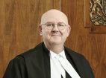
Justice Tholl in dissent
That said, courts must be cautious when engaging in an examination of discoverability and must not cross the line into speculation… Here, it is clear that the shotgun would have been discovered absent the breaches. Speculation is not required.

Slide 37
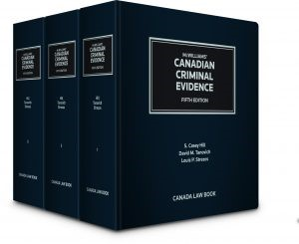
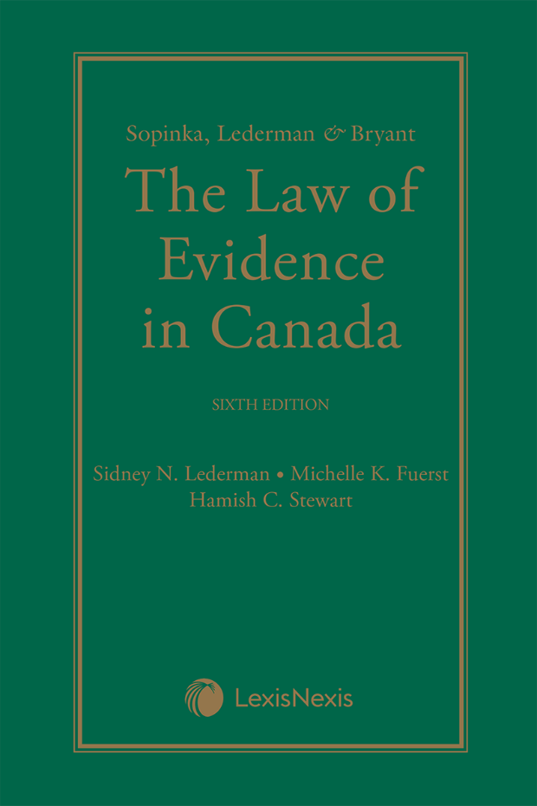
Kent Roach, “Reclaiming Prima Facie Exclusionary Rules in Canada, Ireland, New Zealand, and the United States: The Importance of Compensation, Proportionality, and Non-Repetition,” (2020) Manitoba LJ 43: 1.

