Slide 1
Wrongfully Convicted: Lessons from the Canadian Registry
www.wrongfulconvictions.ca
Kent Roach
kent.roach@utoronto.ca

Slide 2
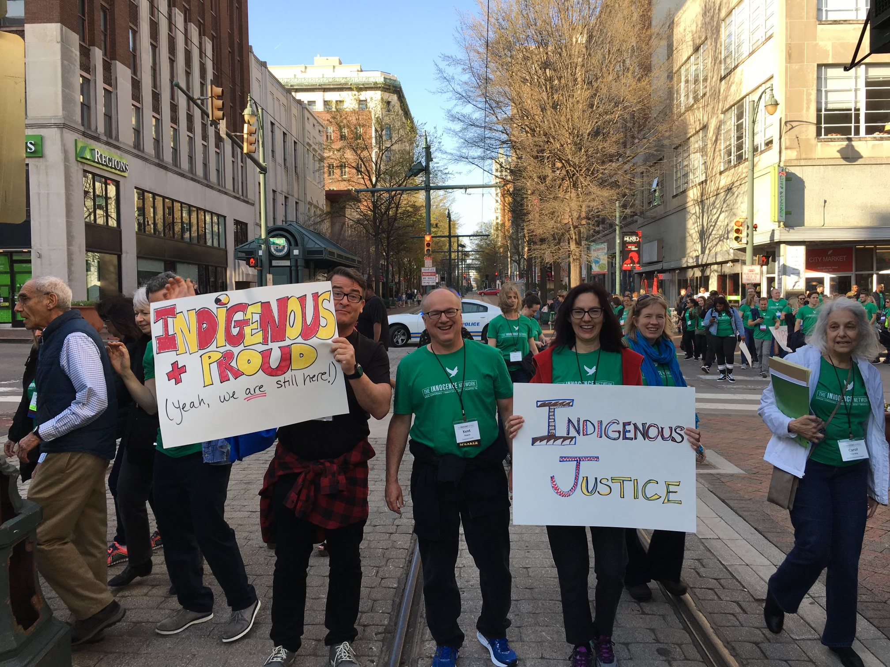
www.wrongfulconvictions.ca

Slide 3
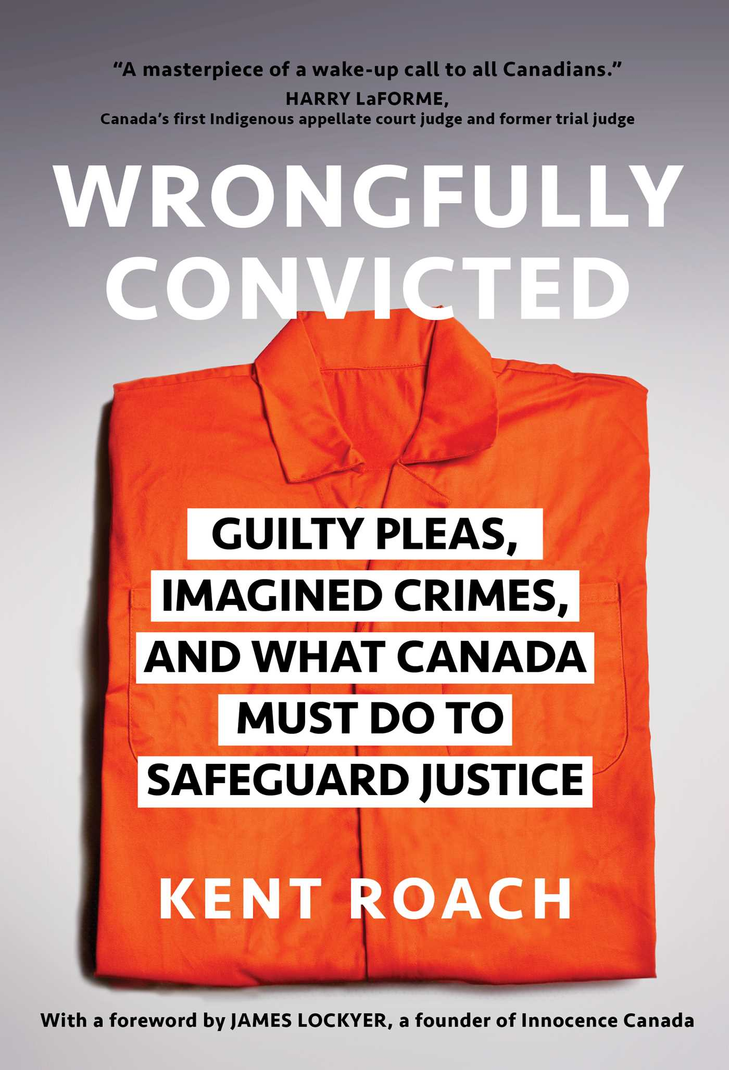
Wrongfully Convicted (2023) discount 25KENTROACH at U of T bookstore

Slide 4
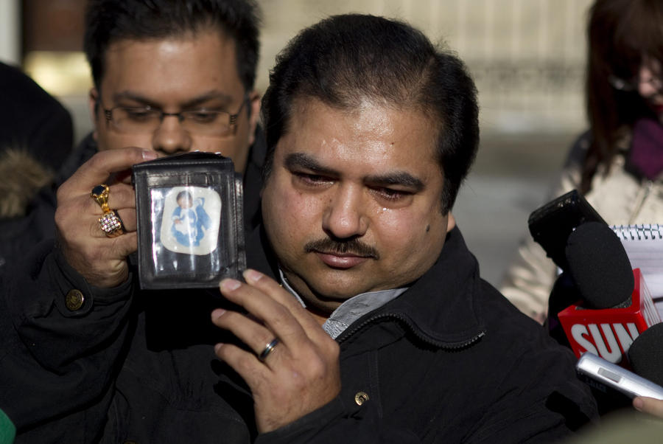
I. False Guilty Pleas

Slide 5
I. False Guilty Pleas
15 of 83 now 16 of 87 remedied wrongful convictions
Why?
Charles Smith cases 5 women and 3 racialized men
Clayton Boucher and Richard Catcheway make rational “time served” decisions to plead guilty
Registry only measures remedied wrongful convictions- not Wilfred Brosseau or Jamie Gladue

Slide 6
I. False Guilty Pleas
Pressure and coercion to accept a plea and sentence discount and often charge discount (murder to manslaughter/infanticide)
Role of defence
Role of prosecutor and FPT Heads of Prosecution Report (2018)
Role of judge and new Bill C-75 Criminal Code s.606(1.1) (c )
Difficulties of re-opening plea
Wong 2018 SCC 25 –would Smith cases meet subjective test
Stress on efficiency and finality

Slide 7
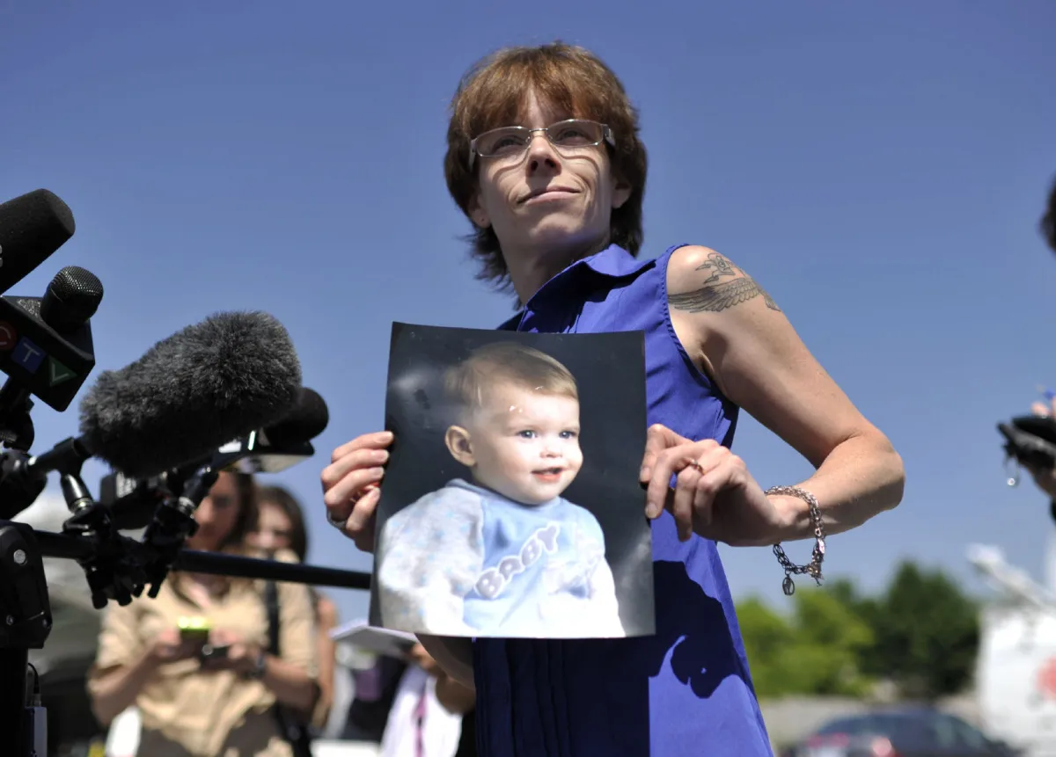
II. Imagined Crimes

Slide 8
II. Imagined Crimes
Crimes that did not happen
A third of remedied wrongful convictions
Smith cases where suspicions and stereotypes blossom into wrongful convictions
“thinking dirty”
Disadvantaged groups
Circumstantial evidence- Jacques Delisle
Presumption of innocence- legal principle and/or fiction?

Slide 9
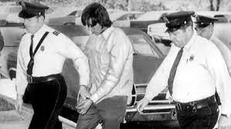
III. Who Done It?

Slide 10
III. Who Done It?

Slide 11
III. Who Done It?
Our best known wrongful convictions
Danger of entertainment
David Milgaard’s case and danger of waiting for DNA that often will not be there and denying tunnel vision or confirmation bias
Need to use case management and other tools and allow defence to investigate
Wrongful conviction amnesia as these cases dry up more than in the US
Glen Assoun, Philip Tallio and difficulties of pointing to alternative suspects

Slide 12
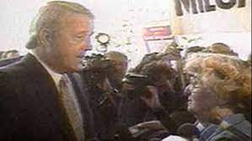
IV. What Must Be Done

Slide 13
IV. What Must be Done
Provincial public inquiries and reluctance to reform the Criminal Code
Still no legislated standards or expert evidence on eyewitness identification
False promise of Jason Hill’s case 2007 SCC 41
False promise of judicial regulation of interrogation and Mr. Big’s
False promise of reforming forensic science province-by-province, discipline-by-discipline
Evidence retention
Appeals and safety/lurking doubt

Slide 14
IV. What Must Be Done
Reforms to prevent wrongful convictions implicate rightful convictions
But Ronald Dworkin’s important equality-based caveat
Need to improve and quicken remedy
Bill C-40 proposes to replace role of federal Minister of Justice in ordering new trial or new appeal after appeals exhausted with a Miscarriage of Justice Review Commission
Concerns about appointments, budget, powers, and jurisdiction especially in guilty plea and sentencing cases

Slide 15
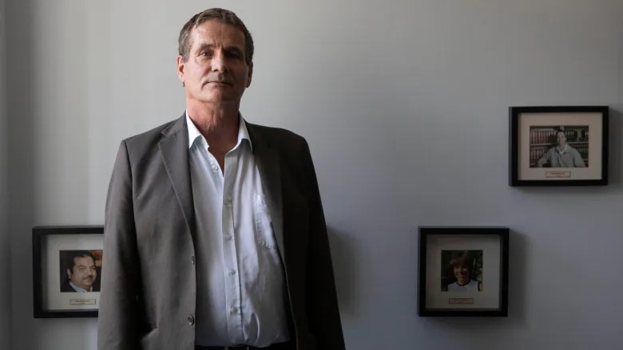
IV. What Must Be Done

